Slide 1
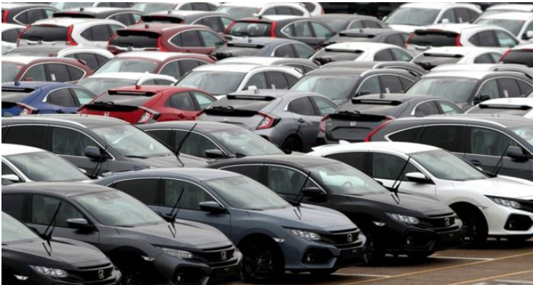

Car Sales Project (using Python and Statistics)
Amit Dhamija
Sep’19 INSAID Batch

Slide 2
Table of Contents
Problem Statement
Introduction
Data source and data set
Observations
Data normalization
Missing data and its imputation
Handling NaN data in categorical variables
Identify patterns in the data
Conclusions
Actionable Insights

Slide 3
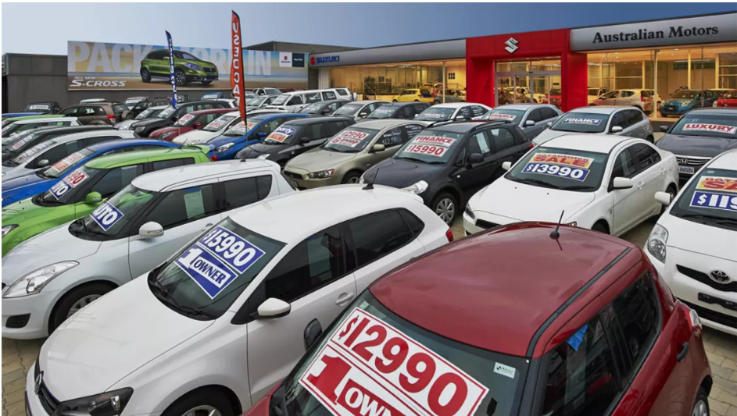
Problem Statement
Introduction
This Exploratory Data Analysis is to practice Python skills learned till now on a structured data set including loading, inspecting, wrangling, exploring, and drawing conclusions from data. The notebook has observations with each step in order to explain thoroughly how to approach the data set.
Based on the observation some questions also are answered in the notebook for the reference though not all of them are explored in the analysis.

Slide 4
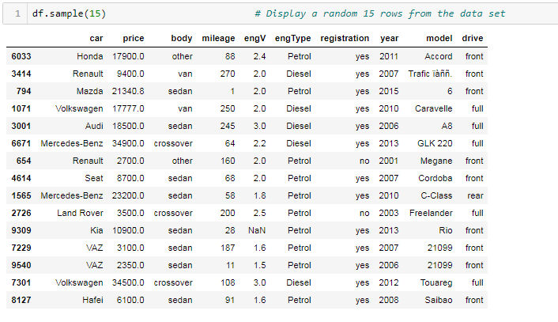
Problem Statement
This dataset is for car sale advertisements for study/practice purposes in 2016. The aim of the project is set to identify trends of used cars based on the choice of users and offer recommendations
Data source and data set
Name: "Car Sales data"
Sponsoring Organization/ Source: Advertisements
Year: 2016
It’s a sample. We don't have official information about the data collection method, but it appears not to be a random sample, so we can assume that it is not representative.
Though there is couple well known car features datasets they seems quite simple and outdated. Car topic is really interesting.
This is how the dataframe looks like :-

Slide 5
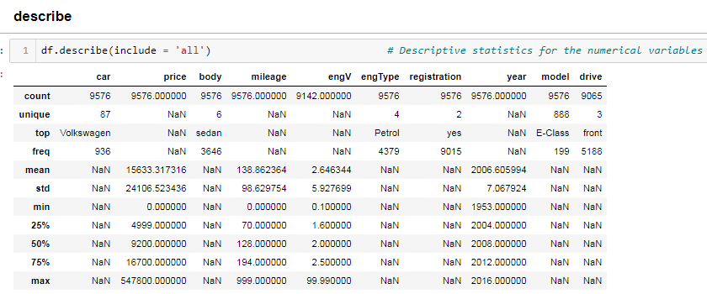
Observations
Descriptive statistics results
car : 87 distinct values.
drive : 511 (5.3%) missing values.
engV : 434 (4.5%) missing values
mileage : 348 (3.6%) zeros
model : 888 distinct values
price : 267 (2.8%) zeros
As we can see there is a huge discrepancy in the dataframe.
drive and engV has missing values. So, we will work on these values and fix them.
Mileage and price have Zeros at 348 and 267 places respectively. This is practically not possible so we need to investigate and fix the same.
For the same we need to clean the data and remove the outliers.

Slide 6
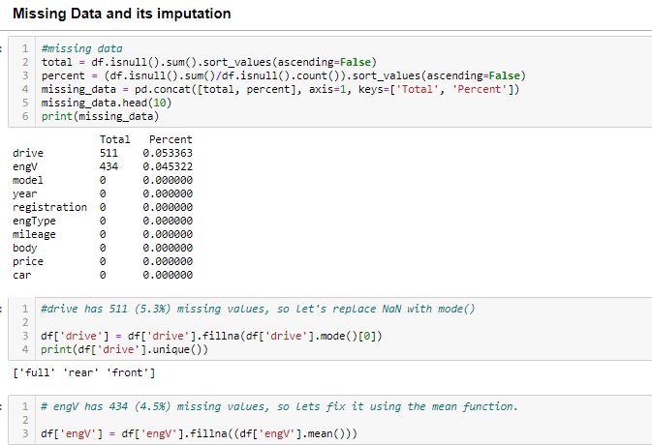


Data Normalization
The picture depicts how the
“Missing data” is sorted using statistics
The picture depicts how the
“Zero values” are replaced using statistics

Slide 7
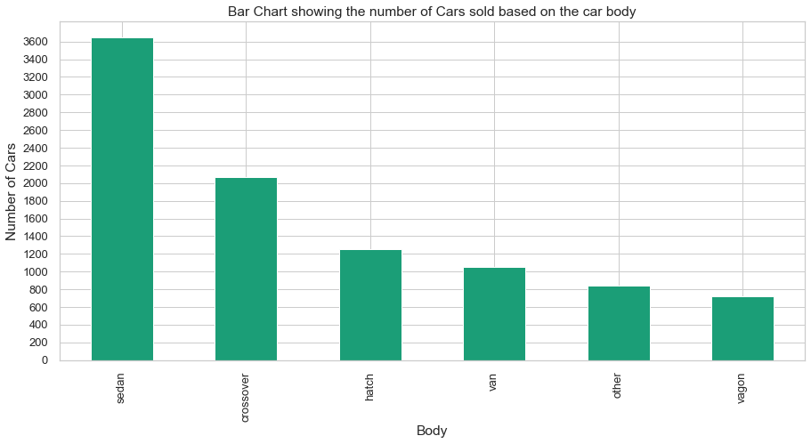
Identify patterns in the data
Maximum cars sold based on the body is sedan type followed by crossover .
vagon type body are the least sold cars.

Slide 8
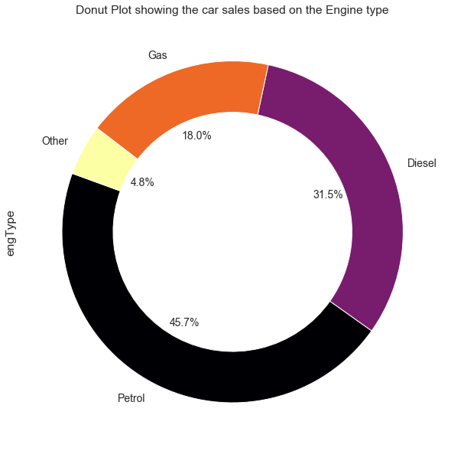
Identify patterns in the data
While buying a second hand car in Ukraine, mostly buyers prefer petrol (45.7%) engine type cars followed by Diesel (31.5%) engine type.

Slide 9
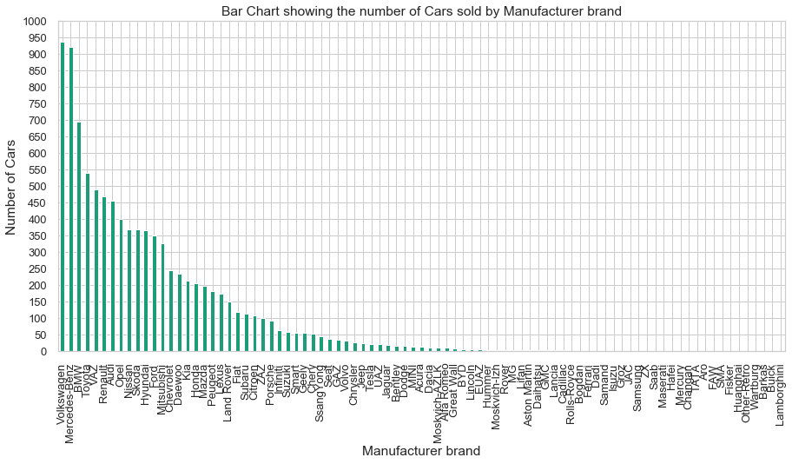
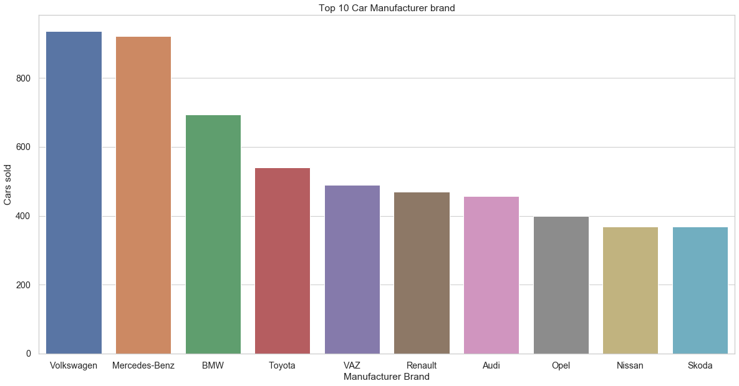
Identify patterns in the data
Volkswagon and Mercedes-Benz are the most sold used cars. We can clearly see the close call between the two brands.
This is followed by BMW and Toyota .

Slide 10
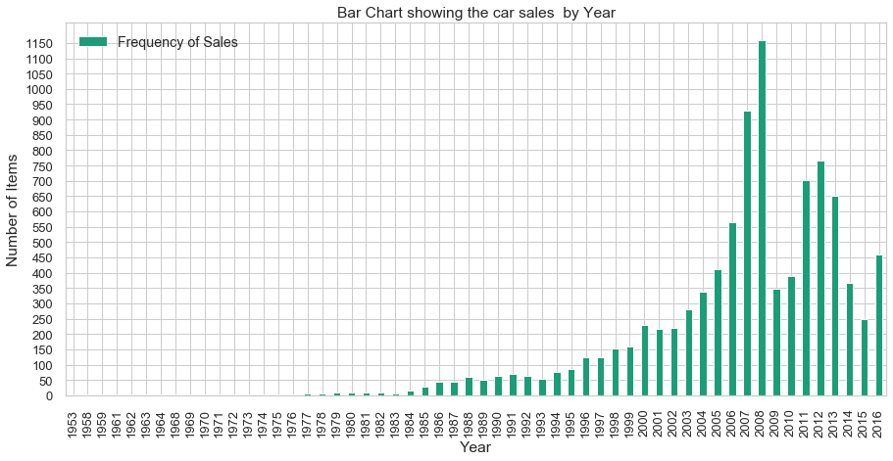
Identify patterns in the data
Maximum used cars were sold in year 2008 followed by 2007. Post which, we dont see much hike in resale of cars.

Slide 11
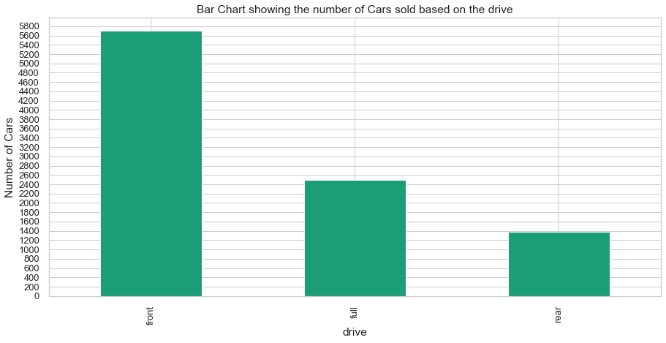
Identify patterns in the data
Mostly buyers have gone for front-wheel drive cars. The reason could be the weight of the drive train is less than that of a rear-wheel vehicle.
Front wheel drive also has certain advantages when the roads get slippery or icy.

Slide 12
Conclusions
Volkswagon and Mercedes-Benz are the most sold used cars. We can clearly see the close call between the two brands which is followed by BMW and Toyota
Maximum used cars were sold in Year-2008 followed by Year-2007. Post which, we don’t see much hike in resale of cars
From the above analysis, its been identified that people in Ukraine while buying a second hand car prefer sedan type cars the most followed by the crossover
Vagon body cars are the least sold cars
In terms of the choice of fuel, mostly buyers are from petrol (45.7%) engine category while being followed by Diesel (31.5%) engine type
Resale of gas running cars is quite less as compared to petrol and diesel
Mostly buyers have gone for front-wheel drive cars. The reason could be the weight of the drivetrain is less than that of a rear-wheel vehicle. Front wheel drive also has certain advantages when the roads get slippery or icy.

Slide 13
Actionable Insights
The trend analysis and graphs indicate that Volkswagon and Mercedes-Benz are top most choice for second hand car buyers. Both of them need to remain consistent in terms of the quality aspects and keep producing long life vehicles for their users
Also, based on the trends identified, it is recommended that the production of sedan and crossover type cars should be given priority as the two categories are the top most choice while re-sale
The focus must given on petrol fuel type cars as this category provide the good re sale stats followed by the diesel fuel type cars
Another interesting fact came out of analysis is that mostly buyers prefer the front-wheel drive cars as their first choice. So manufacturers should consider this choice of customers and focus their production accordingly.

Slide 14

Amit Dhamija
Sep’19 INSAID Batch

